Slide 1
Senior Design
Project Purpose & Goal
"CityScope Dining" aims to empower users to seamlessly filter restaurants by cuisine, curating a tailored dining experience based on individual taste preferences.

Slide 2
Names
Group Members:
Al Ayoola - ayoolam@mail.uc.edu
Stephon Mensah - mensahsk@mail.uc.edu
Tamera Meadows - meadowta@mail.uc.edu
Pacific Mugisha - mugishpc@mail.uc.edu
Project Advisor:
Unknown

Slide 3
Project Abstract
Our web application provides personalized, real-time recommendations of places to visit within a city, tailored to users' specific preferences and needs. Utilizing an intuitive interface, users input criteria such as location type, ratings, and additional features or restrictions. Are you seeking a highly-rated coffee shop with free Wi-Fi in Cincinnati ? or a vegan-friendly Italian restaurant? Our dynamic algorithm sifts through extensive, up-to-date databases to generate a curated list of options, ensuring an optimized, individualized exploration experience. Some key features include real-time data, personalized criteria selection, and an expansive array of venue types for a holistic, user-centric solution to city navigation.

Slide 4
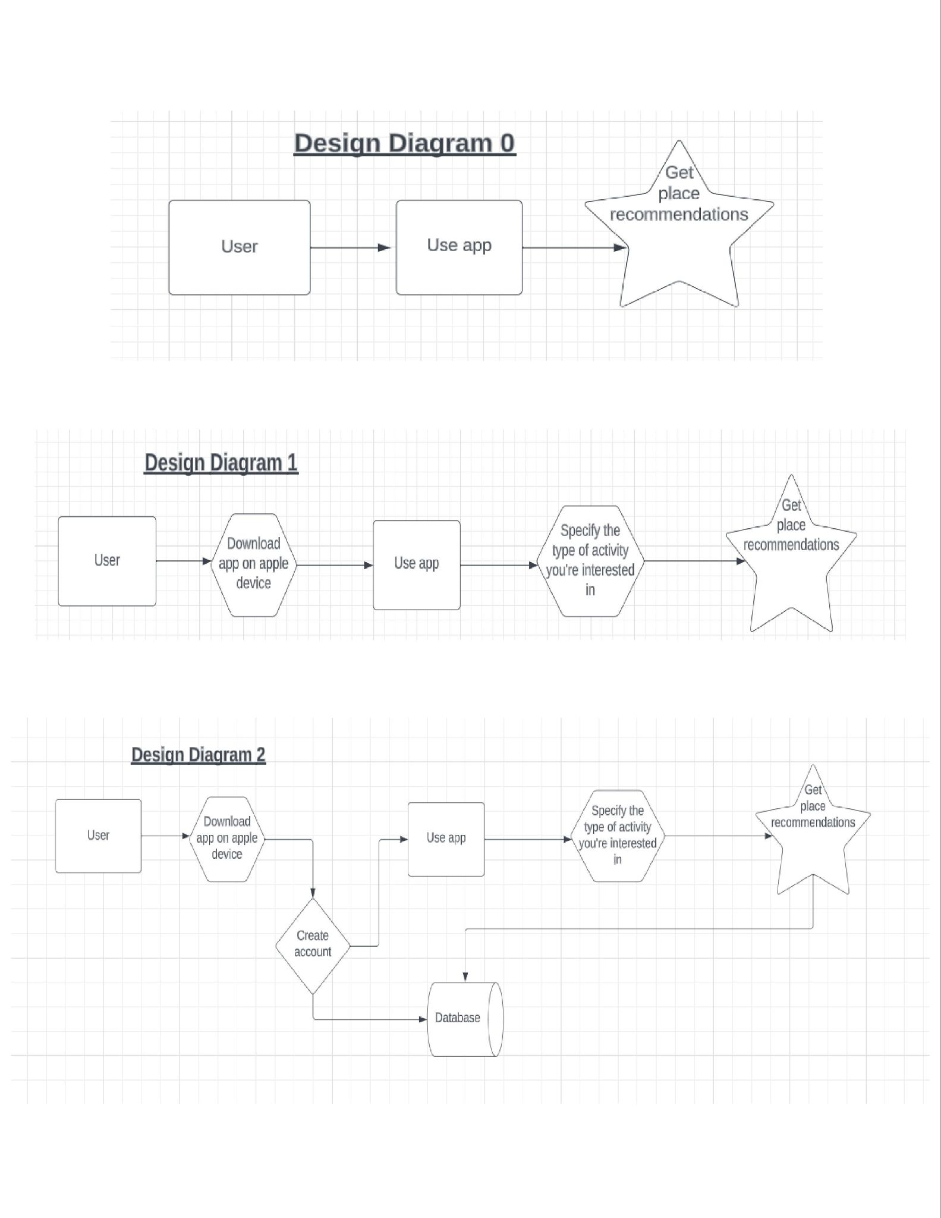
User stories / design diagrams
Design Diagrams

Slide 5
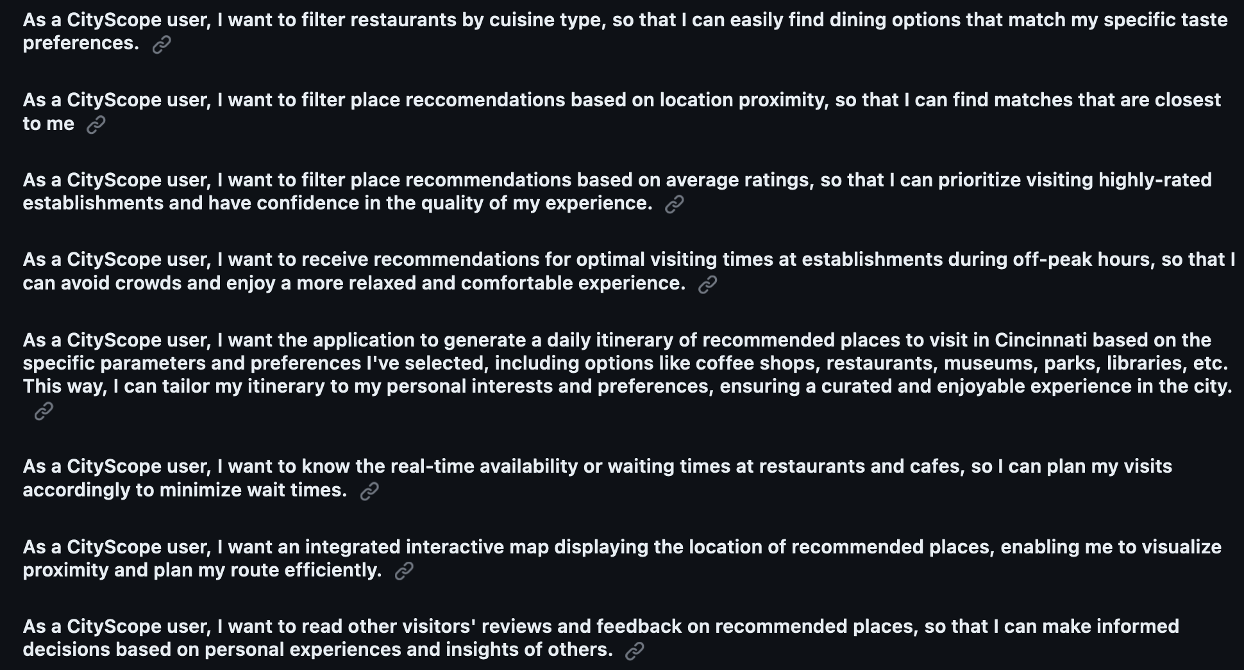
User
Stories

Slide 6
Review of Project Progress
Finalized the project description and design diagrams
Established our project milestones and timeline
Formulated user stories and detailed our task list
Compiled professional bios and our effort matrix
Created a comprehensive team contract

Slide 7
Expect Accomplishment by End of Term
Define Core Features & Functionalities: Clearly outline the essential features based on initial research and user stories.
Design Wireframe Mockup: Create wireframes for different pages of the web application to visualize its layout and design.
Set Up Project Architecture: Decide on the tech stack and database choice for the project.
Establish Data Schemas: Create schemas for storing place information, including ratings, features, and location details.
Curate Database for Cincinnati Places: Begin gathering and organizing a database of places in Cincinnati, ensuring it contains attributes relevant to user preferences.
Research and Planning: Start research on utilizing Java in the context of an android application and gather information on how to integrate the 'Google Maps Platform API'.

Slide 8
Division of Work
| 12. Integrate interactive map | Stephon |
| 13. Implement daily itinerary generator | Al |
| 14. Conduct usability testing | Tamera |
| 15. Conduct integration tests | Pacific|
| 16. Explore third-party APIs/partnerships | Stephon |
| 17. Conduct stress tests | Al |
| 18. Iterate on recommendation algorithm | Stephon|
| 19. Write user manuals/guides | Tamera|
| 20. Integrate user feedback mechanisms | Pacific |
| 21. Research Android Studio | Stephon |
| 22. Design app UI | Tamera |
| 23. Perform UI Testing | Tamera |
| 24. Integrate Google Maps Platform API | Al |
| 25. Research Java for Android app | Pacific |
| Task | Person|
|------|--------|
| 1. Define core features and functionalities | Stephon|
| 2. Design wireframe mockup | Tamera|
| 3. Set up project architecture and tech stack | Al|
| 4. Establish data schemas | Al |
| 5. Curate database of places | Pacific |
| 6. Design recommendation algorithm | Stephon |
| 7. Implement front-end interface | Tamera |
| 8. Code backend logic for recommendations | Al |
| 9. Create results page | Tamera |
| 10. Conduct unit tests | Pacific |
| 11. Add optimal visiting times feature | Pacific |

Slide 9
Expected Demo at Expo
Live Demo: Show real-time usage of our web application, inputting "coffee shops in Cincinnati" with filters such as minimum rating, free wifi, and pet friendly options. Display the list of recommended places.
Interactive Kiosk: Attendees can interact with the app using tablets at our booth, exploring their desired locations and filters to see personalized recommendations.
Engaging Visuals: Screens display vibrant images and reviews of various locations recommended by our app, showcasing its diverse options and user-friendly interface.
Q&A and User Feedback: Team members engage with the audience, answering questions and gathering feedback for future improvements.

